Slide 1
Perfect Poetry Planning!

Slide 2
Revise the key ideas in each poem to help comparison
Don’t bother with introductions and conclusions – unless adding comparison in a conclusion
Analyse key details
Don’t just name techniques for no reason – use it to support analysis and interpretations

Slide 3
In your answer, always consider:
T: THEMES A: ATTITUDES I: IMAGERY L: LANGUAGE S: STRUCTURE & FORM* *FORM = THE TYPE OF POEM & THE WAY IT IS CONSTRUCTED

Slide 4
Note of Caution: Only use the verbs you’re familiar with unless you take the time to examine the definition in the dictionary. This is not a list of synonyms. Each word has specific uses that are unique to its meaning. Potentially most useful are in bold.
Active verbs for writing about texts...
Advises
Affects
Alludes to
Argues
Articulates
Builds
Clarifies
Confirms
Connotes
Constructs
Conveys
Creates
Criticises
Demonstrates
Denotes
Depicts
Describes
Determines
Displays
Encourages
Emphasises
Establishes
Evokes
Exaggerates
Examines
Exemplifies
Expands
Explains
Explores
Exposes
Foreshadows
Foretells
Highlights
Hints
Illustrates
Impacts
Implies
Indicates
Informs
Introduces
Juxtaposes
Manifests
Narrates
Persuades
Portrays
Presents
Refers
Reflects
Relates
Remarks
Represents
Reveals
Shows
Signifies
Symbolises
States
Suggests
Supports
Tells
Typifies
Underlines

Slide 5
Six steps to answering the poetry question
Step 1 – read the questions – pick the one you want to answer and underline key words from the question
Step 2 – pick out a few points you could make about the topic of the question in the named poem
Step 3 – pick your other poem to compare and think about ways this poem links to the points you’ve made about the first one (could be a similarity or a contrast)
Step 4 – underline key quotations from both poems that you can analyse well and that fit the question
Step 5 – write your answer using PEE and making links wherever you can: ideally 3 paragraphs comparing both poems in each (start each paragraph with a sentence linking the poems)
Step 6 – read and check over your answer

Slide 6
Showing similarities
…is similar to…; similarly; like/likewise; equally; as with…; moreover…; in the same way…; in a similar way…
For differences
…in contrast to…; alternatively…; compared with…; in comparison with…; …is different from…; on the other hand; instead of…; however; otherwise…; whereas…; unlike…

Slide 7
Step 1 – read the questions – pick the one your want to answer and underline key words

Slide 8
Step 2 – pick out 3+ points you could make about the relevant theme/attitude/idea in that poem
Identity in The Clown Punk
Identity changes
Identity is to do with personal appearance
Identity can cause misery

Slide 9
Step 3 – pick your other poem to compare, based on the points you’ve considered about the first one
Identity =
Checking out me history
Case history Alison
Portrait of a deaf man
The hunchback in the park
Medusa

Slide 10
Continue Step 3 – pick out 3 points you could make about the theme in the second poem
Identity in the Clown Punk
Case History: Alison
Identity changes
Identity is to do with personal appearance
Identity can cause misery
Her past to present
She gained weight
She is trapped in the present

Slide 11
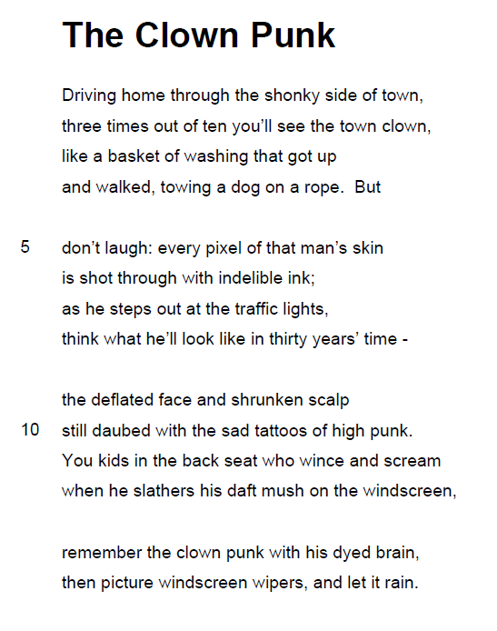
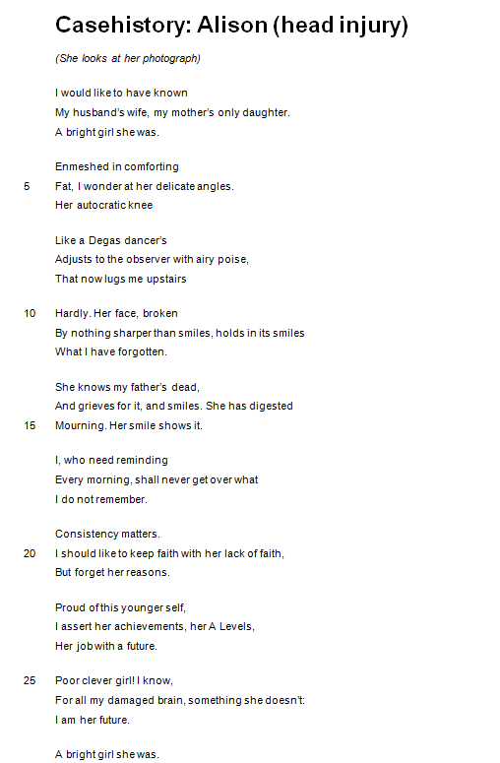
Step 4 – pick out quotations for each of your paragraphs
3. Identity causes misery
enjambment
1. Identity changes
enjambment
2. Identity to do with personal appearance

Slide 12
Step 5 – write your answer: 3 comparative paragraphs
MAKE A LINK AT THE START OF EACH PARAGRAPH (based on your plan)
Both poems show [explore theme/attitude/idea from the question]. Or (Poet A) creates the idea that… , whereas Poet B shows…
THEN EXPLORE HOW THE POETS DO THIS IN EACH POEM:
Poet A uses (technique) to show… +include evidence →explain and analyse word/structural choices and their effects Similarly/conversely, Poet B uses… to… +include evidence
→explain and analyse word/structural choices and their effects
You might then briefly sum up your comparison in this paragraph at the end, or make sure you link back to the first poem when writing about the second one. Make sure you name techniques, analyse word choices, and that you can use more than one piece of evidence for the same point, as long as you analyse each quote/technique one at a time.

Slide 14
Compare the ways poets present ideas about identity in ‘The Clown Punk’ (page 4) and one other poem from Character and voice.

Slide 15
Compare the ways poets present isolated characters in ‘The Hunchback in the Park’ (page 18) and one other poem from Character and voice.

Slide 16
Compare the ways poets present romantic love in ‘Singh Song’ (page 9) and one other poem from Character and voice.

Slide 17
Compare the ways poets present the past and present in ‘Les Grands Seigneurs’ (page 13) and one other poem from Character and voice.

Slide 18
Compare the ways poets present memory in ‘Casehistory: Alison (head injury)’ and one other poem from Character and voice.

Slide 19
Compare how poets use language to explore ideas and feelings in ‘Checking Out Me History’ (page 5) and in one other poem from Character and voice.

Slide 20
Compare the ways poets present ideas about power in ‘Ozymandias’ (page 14) and in one other poem from Character and voice.

Slide 21
Compare the ways poets present powerful characters in ‘My Last Duchess’ (page 15) and one other poem from Character and voice.

Slide 22
Compare the ways poets present strong emotions in ‘Medusa’ (page 8) and one other poem from Character and voice.

Slide 23
Compare the ways poets present male characters in ‘The River God’ and one other poem from Character and voice.

Slide 24
Compare the ways poets present attitudes to change in ‘The Ruined Maid’ and one other poem from Character and voice.

Slide 25
Compare the ways poets present a sense of fantasy in ‘Brendon Gallacher’ and one other poem from Character and voice.

Slide 26
Compare the ways poets present ideas about rejection in ‘Give’ and one other poem from Character and voice.

