Slide 1
To Kill A Mockingbird
Exam Revision

Slide 2
Exam format – no choice of question
Close analysis of a passage from the novel
Analysis of language, structure and form
Understanding of character/theme/context as demonstrated in the passage
Essay question linked to the passage – may be based on a character or theme
Understanding of the novel as a whole
Evaluation of social, historical, cultural context
Interpretations then and now

Slide 3
Part 1 – approaching question

Slide 4
“But Mr Tate said, ‘This court will come to order,’ in a voice that rang with authority, and the heads below us jerked up. Mr Tate left the room and returned with Tom Robinson. He steered Tom to his place beside Atticus, and stood there. Judge Taylor had roused himself to sudden alertness and was sitting up straight looking at the empty jury box.
What happened after that had a dreamlike quality: in a dream I saw the jury return moving like underwater swimmers, and Judge Taylor’s voice came from far away, and was tiny. I saw something only a lawyer’s child could be expected to see, could be expected to watch for, and it was like watching Atticus walk into the street, raise a rifle to his shoulder and pull the trigger, but watching all the time knowing that the gun was empty.
A jury never looks at a defendant is has convicted, and when this jury came in, not one of them looked at Tom Robinson. The foreman handed a piece of paper to Mr Tate who handed it to the clerk who handed it to the judge ...
I shut my eyes. Judge Taylor was polling the jury: ‘Guilty ... guilty ... guilty ... guilty...’ I peeked at Jem: his hands were white from gripping the balcony rail, and his shoulders jerked as if each ‘guilty’ was a separate stab between them.
Judge Taylor was saying something. His gavel was in his fist, but he wasn’t using it. Dimly, I saw Atticus pushing papers from the table into his briefcase. He snapped it shut, went to the court reporter and said something, nodded to Mr Gilmer, and then went to Tom Robinson and whispered something to him. Atticus put his hand on Tom’s shoulder as he whispered. Atticus took his coat off the back of his chair and pulled it over his shoulder. Then he left the courtroom, but not by his usual exit. He must have wanted to go home the short way, because he walked quickly down the middle aisle towards the south exit. I followed the top of his head as he made his way to the door. He did not look up.
Someone was punching me, but I was reluctant to take my eyes from the people below us, and from the image of Atticus’s lonely walk down the aisle.
‘Miss Jean Louise?’
I looked around. They were standing. All around us and in the balcony on the opposite wall, the Negroes were getting to their feet. Reverend Sykes’s voice was as distant as Judge Taylor’s.
‘Miss Jean Louise, stand up. Your father’s passin’.’”
How does Lee’s use of language present emotions in this passage?

Slide 5
Change in pace; language/ vocab choices suggest tension
Imagery of the dream/ simile of ‘underwater swimmers’ > lack of reality to proceedings.
“But Mr Tate said, ‘This court will come to order,’ in a voice that rang with authority, and the heads below us jerked up. Mr Tate left the room and returned with Tom Robinson. He steered Tom to his place beside Atticus, and stood there. Judge Taylor had roused himself to sudden alertness and was sitting up straight looking at the empty jury box.
What happened after that had a dreamlike quality: in a dream I saw the jury return moving like underwater swimmers, and Judge Taylor’s voice came from far away, and was tiny. I saw something only a lawyer’s child could be expected to see, could be expected to watch for, and it was like watching Atticus walk into the street, raise a rifle to his shoulder and pull the trigger, but watching all the time knowing that the gun was empty.
A jury never looks at a defendant is has convicted, and when this jury came in, not one of them looked at Tom Robinson. The foreman handed a piece of paper to Mr Tate who handed it to the clerk who handed it to the judge ...
I shut my eyes. Judge Taylor was polling the jury: ‘Guilty ... guilty ... guilty ... guilty...’ I peeked at Jem: his hands were white from gripping the balcony rail, and his shoulders jerked as if each ‘guilty’ was a separate stab between them.
Narrative perspective of adult; recognises corrupt nature of 1930s justice system
Structure/ short sentence; increase in tension, heightened by the inevitability of the verdict
Atticus presented as powerless; reminds us of shooting of Tim Johnson
Repetition; brutal and unfeeling condemnation of white jury – representative of justice system as a whole

Slide 6
Confusion - adds to dream like imagery of earlier. Child’s perspective heightens injustice, bearing in mind what they have just seen in the court room.
Judge Taylor was saying something. His gavel was in his fist, but he wasn’t using it. Dimly, I saw Atticus pushing papers from the table into his briefcase. He snapped it shut, went to the court reporter and said something, nodded to Mr Gilmer, and then went to Tom Robinson and whispered something to him. Atticus put his hand on Tom’s shoulder as he whispered. Atticus took his coat off the back of his chair and pulled it over his shoulder. Then he left the courtroom, but not by his usual exit. He must have wanted to go home the short way, because he walked quickly down the middle aisle towards the south exit. I followed the top of his head as he made his way to the door. He did not look up.
Someone was punching me, but I was reluctant to take my eyes from the people below us, and from the image of Atticus’s lonely walk down the aisle.
‘Miss Jean Louise?’
I looked around. They were standing. All around us and in the balcony on the opposite wall, the Negroes were getting to their feet. Reverend Sykes’s voice was as distant as Judge Taylor’s.
‘Miss Jean Louise, stand up. Your father’s passin’.’”
Scout’s innocent view of her father- we realise the depth of his response
Hushed reactions of all – verb choices create sense of pathos
Description of Atticus; microcosm for novel as a whole; standing up against injustice – anticipates MLK/ Civil rights struggle
Final dialogue; respect

Slide 7
How does Lee’s use of language present emotions in this passage?
Set passage in context/ engage with question; e.g. What emotions in this passage and why?
Can work through passage methodically, highlighting key points (be careful not to re-tell story)
OR, pull out some key emotions and scan across the passage in short paragraphs
Confusion at verdict e.g. Dreamlike imagery
Tension leading up to verdict e.g. Short sentences
Admiration of Atticus e.g. Scout’s descriptions
Sense of tragic inevitability e.g. Jury not looking, repetition of ‘guilty’

Slide 8
For the question in the exam, you must:
Explore themes/ideas
Analyse language and/or structure to support interpretations
Explore the context, supported with quotations
Remember: this question is in two parts. The first part focuses on analysing the extract, and the second part requires you to relate to the whole book and the context. However, you can cover all bullet points in both sections.

Slide 9
Part 2- approaching question

Slide 10
Sample questions
How does Lee use the trial of Tom Robinson to explore the themes of social and racial prejudice in the town of Maycomb?
In the novel, how does Lee show that other people expect Scout to behave in particular ways? What do you think these expectations show about the society in which the novel is set?
What is the significance of Dill to the novel as a whole?
In the novel as a whole, how does Lee show what life was like in a small town such as Maycomb in 1930s southern America?
How does Lee use Atticus in one other event in the novel to show injustice in America in the 1930s?

Slide 11
Contextual aspects to consider
Harper Lee/ author background
1930s America (setting of novel)
Attitudes towards race
Position of black people
Justice system
Position of women
Legacy of Civil War/ Southern pride
Family life
Typical Southern towns
1960s America (when novel was written)
Civil Rights Movement
Martin Luther King
Attitudes to the novel then and now

Slide 12
Nelle Harper Lee was born in Monroeville, Alabama, in 1926. Like Jem and Scout, her father was a lawyer. She studied at the University of Alabama and worked in New York. There she began work on To Kill a Mockingbird, in the mid 1950s.
It was completed in 1957 and published in 1960 - just before the black civil rights movement in America really took off.
Harper Lee
“Any writer worth his salt writes to please himself...It's a self-exploratory operation that is endless. An exorcism of not necessarily his demon, but of his divine discontent.” Harper Lee
“I never expected any sort of success with 'Mockingbird'... I sort of hoped someone would like it enough to give me encouragement.” Harper Lee
>THINK...WHAT LINKS CAN YOU MAKE BETWEEN HARPER LEE AND THE NOVEL? IS SHE SCOUT? OR IS IT MORE COMPLEX THAN THAT?

Slide 13
In the 1930s, although 50% of the population of Southern towns were black, they had no vote and could not marry white people. The policy of segregation meant that black people had to have their own schools, their own churches, their own football teams, even their own cemeteries.
Such was the hatred of black people by the white people - especially during the Great Depression of the 1930s, when money was tight for everyone - that it was common for black people to be lynched or hanged by a mob well into the 20th century.
Attitudes towards race
“Cry about the simple hell people give other people- without even thinking. Cry about the hell white people give colored folks, without even stopping to think that they're people too.”
QUESTION: What are some of the different attitudes towards black people in the novel? Try and consider language choices too.

Slide 14
Black people were originally brought from Africa to America during the 17th, 18th and 19th centuries. They were forcibly transported across the Atlantic in slave ships (in which many died) and sold as slaves to work on sugar and cotton plantations in the Caribbean and the southern states of north America. They had no rights and were seen by their white owners as little more than animals or machines.
Even after the abolition of slavery in 1865, the blacks were still almost powerless. White Americans had too much to lose to allow black Americans any rights.
Position of black people
Within their own communities, black people could be teachers, doctors or dentists. Outside of it, work included domestic labour, working in the mines, in factories or as delivery boys.
Most people’s first experience with black people was their Nurse; they played the role of parent/mother.

Slide 15
Scottsboro’ Trials -The events that culminated in the trials began in the early spring of 1931, when nine young black men were falsely accused of raping two white women on a train. Despite evidence that exonerated the accused and even a retraction by one of the accusers, the state pursued the case and all-white juries delivered guilty verdicts that initially carried the death penalty. Several of the accused were sentenced to prison terms and all endured long stays in prison as the case made its way through the legal system.
The Jim Crow laws were state and local laws in the United States enacted between 1876 and 1965. They mandated racial segregation in all public facilities in Southern states of the former Confederacy, with, starting in 1890, a "separate but equal" status for African Americans.
Justice system
The historian Michael Klarman writes, “Virtually no southern politician could survive in this political environment without toeing the massive resistance line, and in most states politicians competed to occupy the most extreme position on the racial spectrum.”
“There is one way in this country in which all men are created equal—there is one human institution that makes a pauper the equal of a Rockefeller, the stupid man the equal of an Einstein, and the ignorant man the equal of any college president. That institution, gentlemen, is the court.”

Slide 16
“The one place where a man ought to get a square deal is in a courtroom, be he any color of the rainbow, but people have a way of carrying their resentments right into a jury box. As you grow older, you'll see white men cheat black men every day of your life, but let me tell you something and don't you forget it - whenever a white man does that to a black man, no matter who he is, how rich he is, or how fine a family he comes from, that white man is trash.
Justice system
QUESTION: What view does Lee give us of the justice system in 1930s America? Is there any justice in the novel?

Slide 17
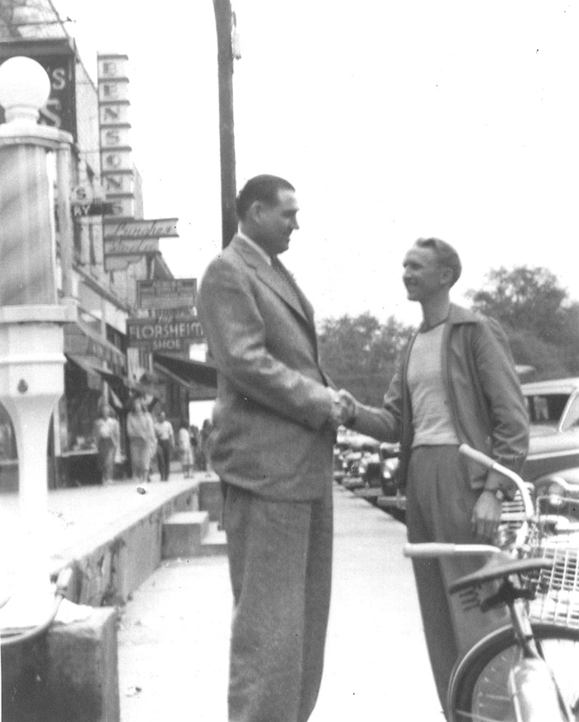
Real-life inspiration for Atticus?
Big Jim Folsom was a politician in Alabama in the 1950s. Folsom would end his speeches by brandishing a corn-shuck mop and promising a spring cleaning of the state capitol. He was against the Big Mules, as the entrenched corporate interests were known. He worked to extend the vote to disenfranchised blacks. He wanted to equalize salaries between white and black schoolteachers. He routinely commuted the death sentences of blacks convicted in what he believed were less than fair trials. He made no attempt to segregate the crowd at his inaugural address. “Ya’ll come,” he would say to one and all, making a proud and lonely stand for racial justice.
Whenever he was accused of being too friendly to black people, Folsom shrugged. His assumption was that black people were citizens, just like anyone else. “I just never did get all excited about our colored brothers,” he once said. “We have had them here for three hundred years and we will have them for another three hundred years.”

Slide 18
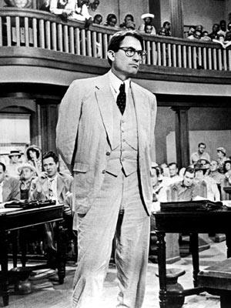
Liberal humanitarianism rather than activism?
Think about the scene that serves as the book’s centrepiece. Finch is at the front of the courtroom with Robinson. The jury files in. In the balcony, the book’s narrator—Finch’s daughter, Jean Louise, or Scout, as she’s known—shuts her eyes. “Guilty,” the first of the jurors says. “Guilty,” the second says, and down the line: “guilty, guilty, guilty.” Finch gathers his papers into his briefcase. He says a quiet word to his client, gathers his coat off the back of his chair, and walks, head bowed, out of the courtroom.
If Finch were a civil-rights hero, he would be brimming with rage at the unjust verdict. But he isn’t. He’s not looking for racial salvation through the law. He’s Jim Folsom, looking for racial salvation through hearts and minds.
“If you can learn a simple trick, Scout, you’ll get along a lot better with all kinds of folks,” Finch tells his daughter. “You never really understand a person until you consider things from his point of view . . . until you climb into his skin and walk around in it.” He is never anything but gracious to his neighbor Mrs. Dubose, even though she considers him a “nigger-lover.” He forgives the townsfolk of Maycomb for the same reason. They are suffering from a “sickness,” he tells Scout—the inability to see a black man as a real person. All men, he believes, are just alike.
QUESTION: IS THIS KIND OF SOCIAL CHANGE POSSIBLE, SIMPLY BY UNDERSTANDING EACH OTHER, OR IS SOMETHING MORE RADICAL NEEDED?

Slide 19
"For one thing, Miss Maudie can't serve on a jury because she's a woman-"
"You mean women in Alabama can't-?" I was indignant.
"I do. I guess it's to protect our frail ladies from sordid cases like Tom's. Besides," Atticus grinned, "I doubt if we'd ever get a complete case tried—the ladies'd be interrupting to ask questions."
Being a ‘gentleman’ seems to signify honour in a way being a lady doesn't, at least for Jem. How do ladies show their honour?
What might the female characters in the novel represent? Try to compare and contrast them:
Scout
Miss Caroline Fisher
Miss Maudie
Mrs Dubose
Aunt Alexandra
Miss Stephanie
Miss Rachel
Mrs Merriweather
Helen Robinson
Missionary Circle
Mayella Ewell
Dill’s absent mother
Position of women
Atticus calls Southern Womanhood a ‘polite fiction’. What does he mean?
Being a girl for Scout is less a matter of what she's born with and more a matter of what she does; she believes in nurture over nature. Arguably the novel is as much about negotiating her femininity as it is anything else.

Slide 20
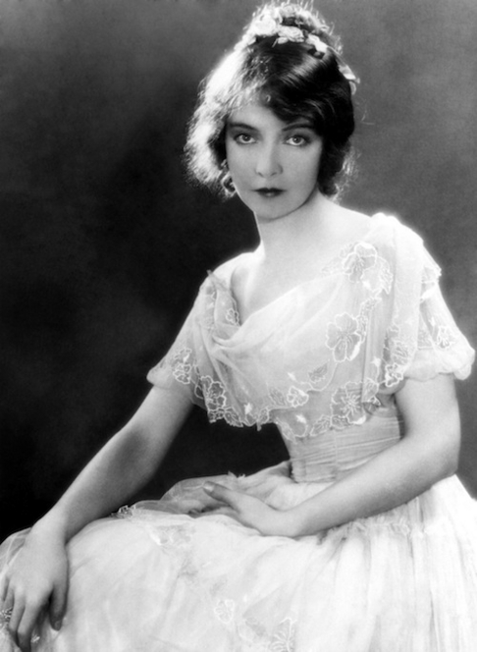
“Ladies in bunches always filled me with vague apprehension and a firm desire to be elsewhere, but this feeling was what Aunt Alexandra called being "spoiled."
The ladies were cool in fragile pastel prints: most of them were heavily powdered but unrouged; the only lipstick in the room was Tangee Natural. Cutex Natural sparkled on their fingernails, but some of the younger ladies wore Rose. They smelled heavenly. I sat quietly, having conquered my hands by tightly gripping the arms of the chair, and waited for someone to speak to me.”
I was more at home in my father's world. People like Mr. Heck Tate did not trap you with innocent questions to make fun of you; even Jem was not highly critical unless you said something stupid. Ladies seemed to live in faint horror of men, seemed unwilling to approve wholeheartedly of them. But I liked them. There was something about them, no matter how much they cussed and drank and gambled and chewed; no matter how undelectable they were, there was something about them that I instinctively liked... they weren't—
"Hypocrites, Mrs. Perkins, born hypocrites," Mrs. Merriweather was saying.
QUESTION: What do you think Lee has to say about the position of women in society as a whole?

Slide 21
“Simply because we were licked a hundred years before we started is no reason for us not to try to win.”
The American Civil War was fought from 1861 to 1865 between the United States (North) and several Southern slave states that declared their secession and formed the Confederate States of America. The war had its origin in the issue of slavery, especially the extension of slavery into the western territories. Woefully ill-equipped, the South was beaten and slavery was abolished. The death toll was estimated at ten percent of all Northern males 20–45 years old, and 30 percent of all Southern white males aged 18–40.
Southern gentleman stereotype – manners but good with a gun!
Legacy of Civil War/ Southern pride
Southern pride stems from origins and being able to trace your line back to first English settlers or 1066, as Aunt Alexandra puts it.
Confederate nationalism died. American nationalism triumphed. The North and West grew rich while the once-rich South became poor for a century. The national political power of the slave-owners and rich southerners ended.
QUESTION: WHERE DO WE SEE TENSIONS BETWEEN DIFFERENT KINDS OF SOUTHERN IDENTITY?

Slide 22
‘No, everybody's gotta learn, nobody's born knowin'. That Walter's as smart as he can be, he just gets held back sometimes because he has to stay out and help his daddy. Nothin's wrong with him. Naw, Jem, I think there's just one kind of folks. Folks.’
“Dill?" “Mm?" “Why do you reckon Boo Radley’s never run off?" Dill sighed a long sigh and turned away from me. “Maybe he doesn't have anywhere to run off to.”
Family life
‘Dill was off again. Beautiful things floated around in his dreamy head. He could read two books to my one, but he preferred the magic of his own inventions. He could add and subtract faster than lightning, but he preferred his own twilight world, a world where babies slept, waiting to be gathered like morning lilies.’
QUESTIONS:
What kinds of family do we see in the novel?
What is the purpose of the family in the novel?
What’s the difference between Atticus and Aunt Alexandra’s view of the family?
What role does Dill play when exploring the theme of family?

Slide 23
“Maycomb was a tired old town, even in 1932 when I first knew it. Somehow, it was hotter then. Men's stiff collars wilted by nine in the morning. Ladies bathed before noon after their three o'clock naps. And by nightfall were like soft teacakes with frosting from sweating and sweet talcum. The day was twenty-four hours long, but it seemed longer. There's no hurry, for there's nowhere to go and nothing to buy...and no money to buy it with.”
Jem was staring at his half-eaten cake. “It’s like bein’ a caterpillar in a cocoon, that’s what it is,” he said. “Like somethin’ asleep wrapped up in a warm place. I always thought Maycomb folks were the best folks in the world, least that’s what they seemed like.” “We’re the safest folks in the world,” said Miss Maudie. “We’re so rarely called on to be Christians, but when we are, we’ve got men like Atticus to go for us.”
Typical Southern towns
Harper Lee said Maycomb was supposed to represent any Southern town.
QUESTION: How is Maycomb a microcosm for 1930s America as a whole?

Slide 24
“If there's just one kind of folks, why can't they get along with each other? If they're all alike, why do they go out of their way to despise each other? Scout, I think I'm beginning to understand something. I think I'm beginning to understand why Boo Radley's stayed shut up in the house all this time. It's because he wants to stay inside.”
“Neighbors bring food with death and flowers with sickness and little things in between. Boo was our neighbor. He gave us two soap dolls, a broken watch and chain, a pair of good-luck pennies, and our lives. But neighbors give in return. We never put back into the tree what we took out of it: we had given him nothing, and it made me sad.”
“Atticus said to Jem one day, "I’d rather you shot at tin cans in the backyard, but I know you’ll go after birds. Shoot all the blue jays you want, if you can hit ‘em, but remember it’s a sin to kill a mockingbird." That was the only time I ever heard Atticus say it was a sin to do something, and I asked Miss Maudie about it. "Your father’s right," she said. "Mockingbirds don’t do one thing except make music for us to enjoy. They don’t eat up people’s gardens, don’t nest in corn cribs, they don’t do one thing but sing their hearts out for us. That’s why it’s a sin to kill a mockingbird.”
Looking at these three quotes, what do you think Harper Lee views as the main problem within 1930s society? How might it be overcome?

Slide 25
“Cry about the simple hell people give other people- without even thinking. Cry about the hell white people give colored folks, without even stopping to think that they're people too.”
“Some negroes lie, some are immoral, some negro men are not be trusted around women - black and white. But this is a truth that applies to the human race and to no particular race of men.”
The civil rights movement was and is a worldwide political movement for equality before the law. In many situations it took the form of campaigns of civil resistance aimed at achieving change by non-violent forms of resistance.
Civil Rights Movement
Rosa Parks: "the first lady of civil rights" and "the mother of the freedom movement. Refuses to give up her seat in 1953.
QUESTIONS:
In what ways do we see the beginnings of the Civil Rights Movement in 1930s Maycomb?
To what extent can we view the novel as part of the movement (e.g. As a protest novel)?

Slide 26
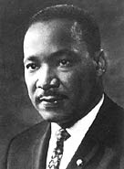
In 1957, King was active in the organisation of the Southern Leadership Christian Conference (SCLC), formed to co-ordinate protests against discrimination. He advocated non-violent direct action based on the methods of Gandhi, who led protests against British rule in India culminating in India's independence in 1947.
King first achieved national renown when he helped mobilise the black boycott of the Montgomery bus system in 1955. This was organised after Rosa Parks, a black woman, refused to give up her seat on the bus to a white man - in the segregated south, black people could only sit at the back of the bus. The 382-day boycott led the bus company to change its regulations, and the supreme court declared such segregation unconstitutional.
Martin Luther King
As the civil rights movement became increasingly radicalised, King found that his message of peaceful protest was not shared by many in the younger generation. King began to protest against the Vietnam war and poverty levels in the US. He was assassinated on 4 April 1968 during a visit to Memphis, Tennessee
King participated in the enormous civil rights march on Washington in August 1963, and delivered his famous 'I have a dream' speech, predicting a day when the promise of freedom and equality for all would become a reality in America. In 1964, he was awarded the Nobel Peace Prize. In 1965, he led a campaign to register blacks to vote. The same year the US Congress passed the Voting Rights Act outlawing the discriminatory practices that had barred blacks from voting in the south.
.
CAN YOU THINK OF ANY SIMILARITIES BETWEEN MLK AND ATTICUS?

Slide 27
BANNED
According to the American Library Institute, frequent attempts have been made ban the novel; it’s the 21st ‘most challenged’ book of the 21st century
BEST-SELLER
When published in 1960, went straight into best-seller chart, selling more than 500,000 copies in the first 6 months. To date, it has been translated into 40 languages and in 2010, had sold 30 million copies.
LONG-LASTING AND MUCH-LOVED
In 1999, it was voted best novel of the 20th century. In 2006, British readers voted it as the book every adult should read before they die.
Interpretations over time
PRIZE-WINNING
It won the Pulitzer Prize in 1961 and 1962, was adapted into an Oscar-winning film. Atticus Finch was voted as the greatest film of the 20th century.
Questions:
Why do you think the novel was so popular at the time of its publication?
Why does the novel continue to be so popular with readers all over the world?
What might modern-day readers empathise with?
What did you enjoy about the novel?

Slide 28
Essay planning
Working in groups, create a detailed essay plan for the question you have been allocated.
Ensure explore the significance of context and include quotes.

